Slide 1
Intermediate - Topic 2 – Using and Sharing Documents
Starter
Open up your Topic 2 Document from your My Documents – Introduction folder. Help others.
Username – 21SmithJ@croftonschool.co.uk
Password (You chose this last lesson and wrote it on the Topic 1 PowerPoint)

Slide 2
Mastery Statements Level 4 – 5
Mastery 4
I can use different applications to help make an information bulletin.
I can make an information bulletin about Office 365 for a given age group making my own image.
I can describe Office 365 stating what it does.
I can work with a friend to create the bulletin.
I can make improvements once I have received feedback.
Mastery 5
I can show how valuable Office 365 is to the school.
I can show the good and bad ethics of using IT to collaborate outside of school using examples.
I can design criteria for someone to critically evaluate my work.
I can make improvements to my work.

Slide 3
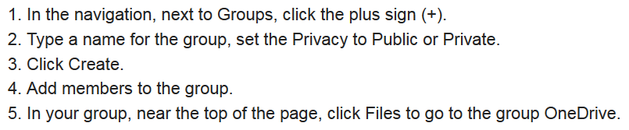
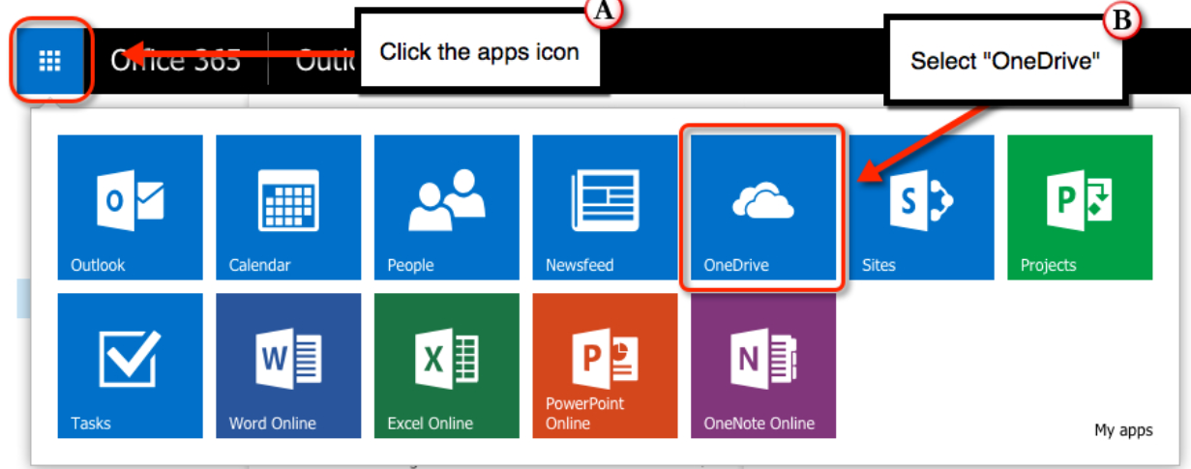
Intermediate - Topic 2 – Using and sharing documents
?
Intermediate:
4 to 5
What is your target grade 4 or
5?:
Today we are going to use and share documents using Office 365.

Slide 4
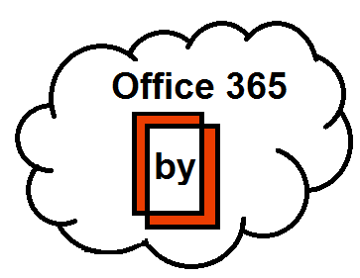
Topic 2 – Using and Sharing Documents
Task:
Using Office 365 create a shared document with at least one other member of the class.
Explain in your document the following:
What email is
How can you use your phone with Office 365 for school based information
How can you collaborate online?
How valuable is Office 365 to the school?
What are the good and bad ethics of using IT to collaborate outside of school?
You could make your own image using the images online?
Gain feedback.
Act on feedback

Slide 5
How have I done?
 | Self Ass Y/N
A
B
C
D
E
F
G
Mastery 4
4(1) I used different software to make a bulletin about Office 365.
4(2) I made a bulletin for adults making my own image.
4(3) I stated what the positive and negatives were with using 365.
4(4) 4(4) I got some www’s about my work
4(4) I got some ebi’s about my work.
4(4) I improved my work.
2(5) I made improvements to my work.
Mastery 5 is on the next slide.

Slide 6
How have I done?
 | Self Ass Y/N
A
B
C
D
E
Mastery 5
5(1) I showed how valuable using Office 365 is.
5(2) I showed the good and bad ethics of using IT outside of school using examples.
5(3) I made sure I received some valuable www feedback.
5(3) I made sure I received some valuable ebi feedback.
5(3) I was able to improve my work and state what I did to improve it.

